Slide 1
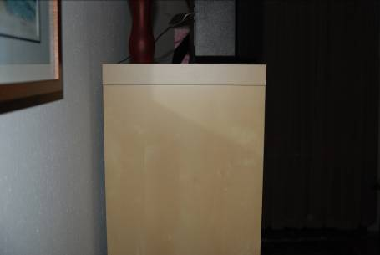
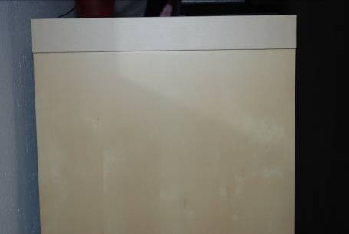
Field Test Photos
Nikon D80 and Krimesite Imager
Establishing shot of shelf
identified with Krimesite canvass
as area of interest.
f/3.3, 1/60 sec, 28mm, ISO-200, flash
Closer view of shelf with no
visible latent prints. Area of
interest circled in red.
f/4.5, 1/60 sec, 50mm, ISO-200, flash

Slide 2
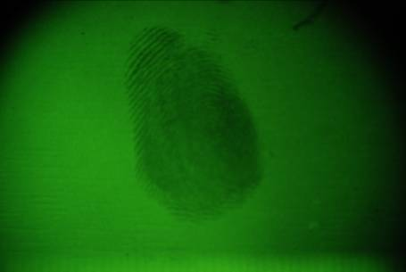
Field Test Photos
Nikon D80 and Krimesite Imager
Close-up of shelf using Krimesite
with visible light filter. No latent
prints visible.
f/4.5, 50mm, 1/3 sec, ISO-100, no flash
Same area using Krimesite
with UV light filter. Latent print
with ridge detail clearly visible.
f/4.5, 50mm, 1/2 sec, ISO-100, no flash

Slide 3
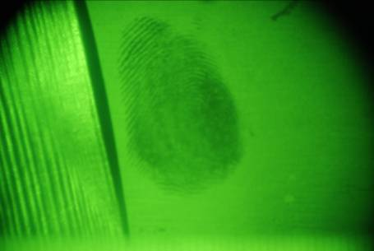
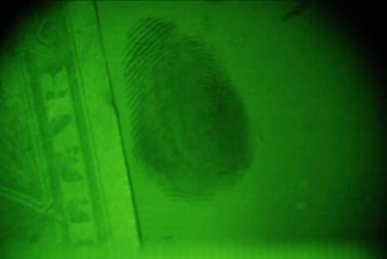
Field Test Photos
Nikon D80 and Krimesite Imager
Close-up of latent print with
plastic ruler used as scale. Note
no numbers visible on the ruler due
to the UV absorption.
f/4.5, 50mm, 1 sec, ISO-100, no flash
Close-up of latent print with
dollar bill used as scale. Printing
clearly visible under UV light.
f/4.5, 50mm, 1/2 sec, ISO-100, no flash

Slide 4
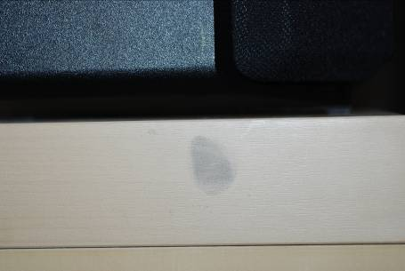
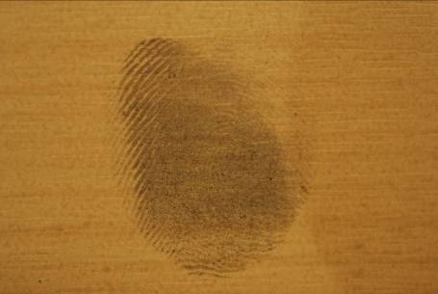
Field Test Photos
Nikon D80 and Krimesite Imager
Latent print on shelf visible in natural
light after development with black
magnetic powder.
f/3.3, 60mm macro, 1/60 sec, ISO-200,
flash
Close-up of latent print after
development with magnetic powder.
Ridge detail is comparable to that seen
with the Krimesite.
f/4, 60mm macro, 4.5 sec, ISO-100, no flash

